Slide 1
Numerical Analysis (1/7) Errors in numerical analysis
University of Luxembourg - 2024
Master in Mathematics
Hadrien Beriot
Restricted

Slide 2
Outline
1.1 Introduction
1.2 Sources of approximation
1.3 Representation of real numbers
1.4 Floating point arithmetic
1.5 Conditioning and stability
1.6 Summary

Slide 3

1.1 Introduction

Slide 4
Problem-solving process
Develop a mathematical model - usually expressed by equations of some type - of a physical phenomenon or system of interest *
Develop algorithms to solve the equations numerically *
Implement the algorithms in computer software *
4. Run the software on a computer to simulate the physical process numerically
5. Post-process results in some comprehensible form such as graphical visualization
6. Interpret and validate the computed results, repeating any or all the preceding steps, if necessary
We focus here on Steps 2 & 3
* Primary tool = literature reviews, reading prior art
Notes:
Steps 2 and 3—designing, analyzing, implementing, and
using numerical algorithms and software—are the main subject matter of scientiﬁc
computing, and of this course

Slide 5
General strategy
Strategy = replace the original problem with an easier one that has a close enough solution
Notes:
• How can we do that, examples?

Slide 6
Strategy
Replacing inﬁnite-dimensional spaces with ﬁnite-dimensional spaces
Replacing inﬁnite processes with ﬁnite processes, such as replacing integrals or
inﬁnite series with ﬁnite sums, or derivatives with ﬁnite diﬀerences
Replacing diﬀerential equations with algebraic equations (finite difference)
Replacing nonlinear problems with linear problems
Replacing high-order systems with low-order systems
Replacing complicated functions with simple functions, such as polynomials
Replacing general matrices with matrices having a simpler form
…
Much of our eﬀort → identifying transformations into simpler “solution-preserving” problems
Notes:
An alternative problem, or class of problems, that is easier to solve
A transformation of the given problem into a problem of this alternative type
that preserves the solution in some sense

Slide 7
Computer & scientists Different flavors
The computer engineer designs a new computer.
The computer scientist develops the operating system and networking software for the computer.
The computational engineer or numerical analyst uses computers and devises algorithms
to solve mathematical models
for complex systems
simulate behaviors
and analyze simulation output.
Physics &
Engineering
Mathematics
Numerical Analyst
Computer science

Slide 8

1.2 Sources of approximation

Slide 9



Sources of Approximation
The surface area of the Earth might be computed using the formula
$$A=4πr^{2}$$
The use of this formula involves several approximations:
Can you list some of them?
Earth is modeled as a sphere (idealization)
Radius, r ≈ 6370 km, is based on empirical measurements and previous evaluations
Number $π$ is given by an inﬁnite limiting process, which must be truncated at some point
Input data, as well as results are rounded in a computer
The accuracy of the computed result depends on all of these approximations.
Notes:
•
Newton’s gravitational constant or Planck’s constant—typically yield values with at most eight or nine signiﬁcant decimal digits, and most laboratory measurements are much
less accurate than that.
Truncation or discretization: Some features of a mathematical model may
be omitted or simpliﬁed (e.g., replacing derivatives by ﬁnite diﬀerences or using
only a ﬁnite number of terms in an inﬁnite series).
Rounding: Whether in hand computation, a calculator, or a digital computer,
the representation of real numbers and arithmetic operations upon them is ulti-
mately limited to some ﬁnite amount of precision and thus is generally inexact.

Slide 10
Sources of Approximation
Modeling (friction/viscosity/air resistance)
Measurements (noise)
Previous computations (inaccurate inputs)
Truncation / discretization / computational: from continuous to discrete
Rounding: computer floating-point representation
In this course, we focus on 4. and 5.

Slide 11
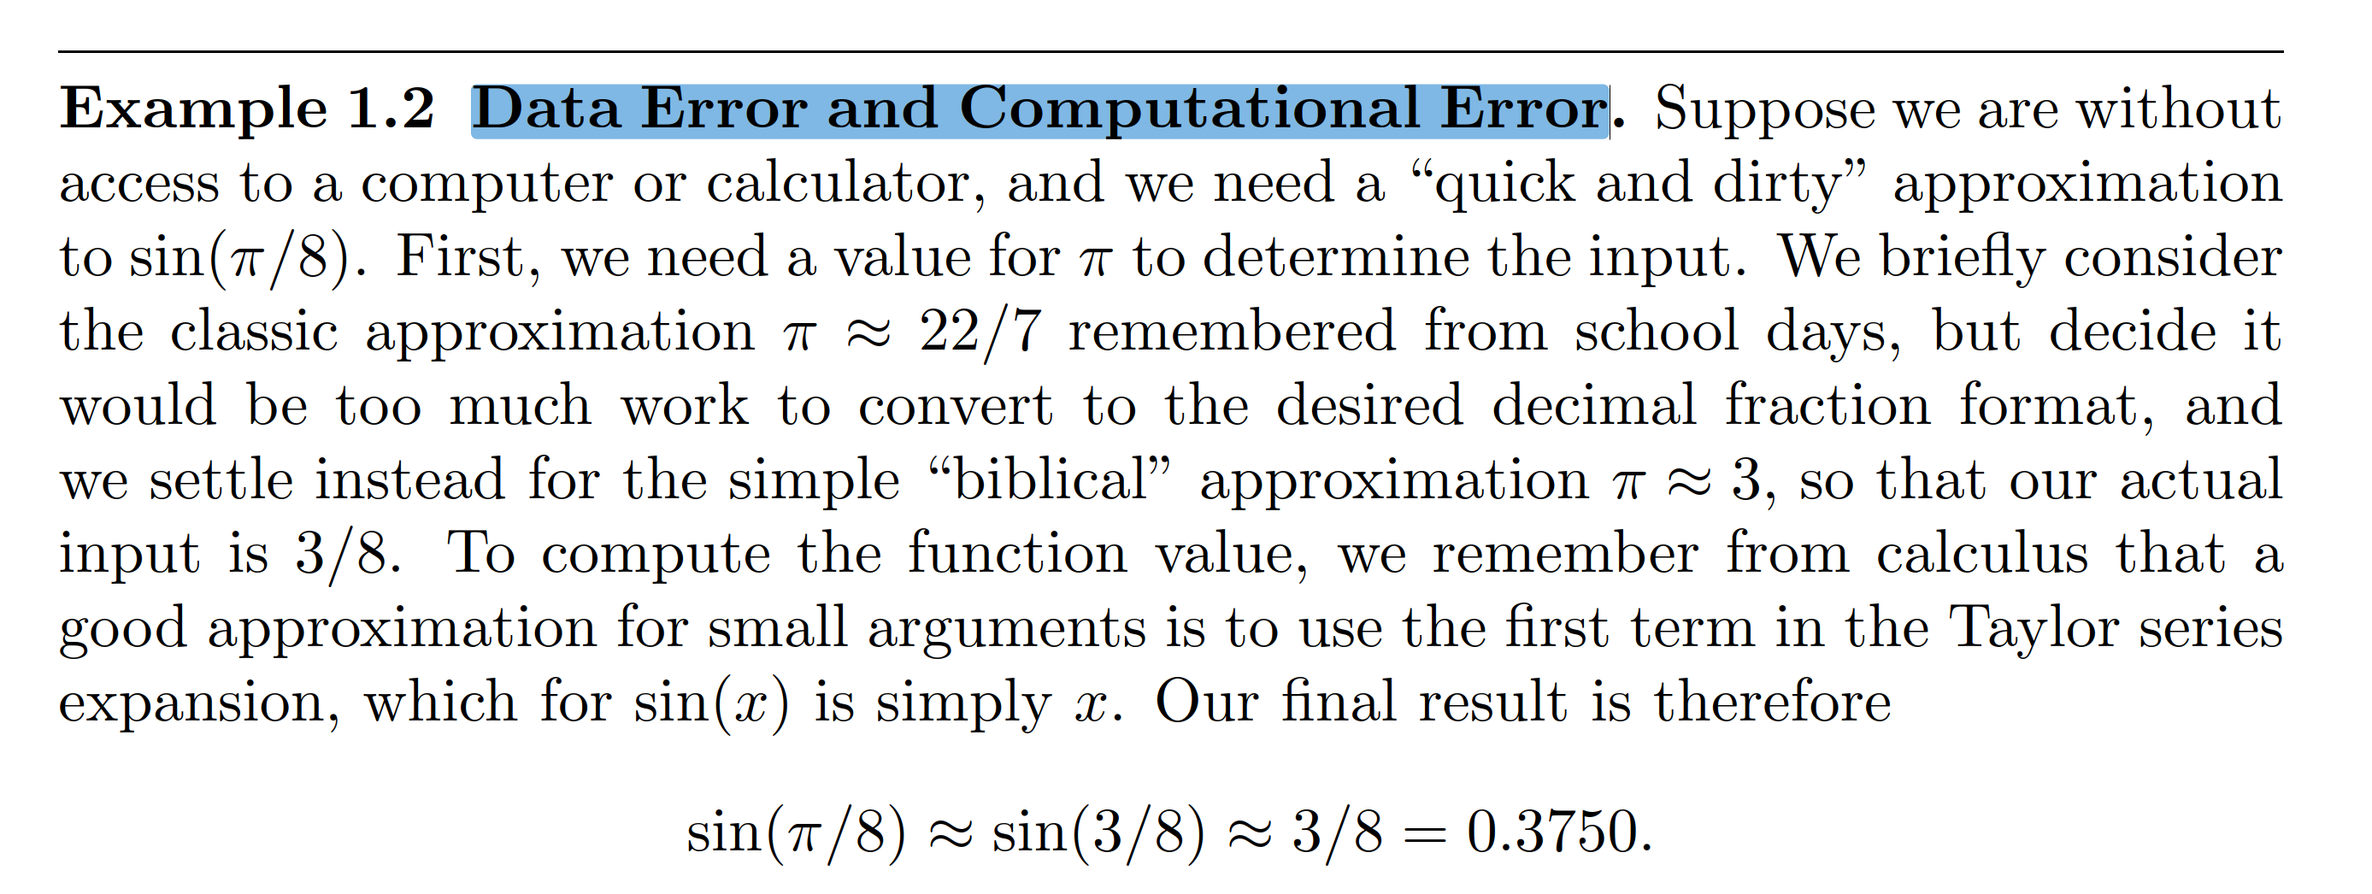
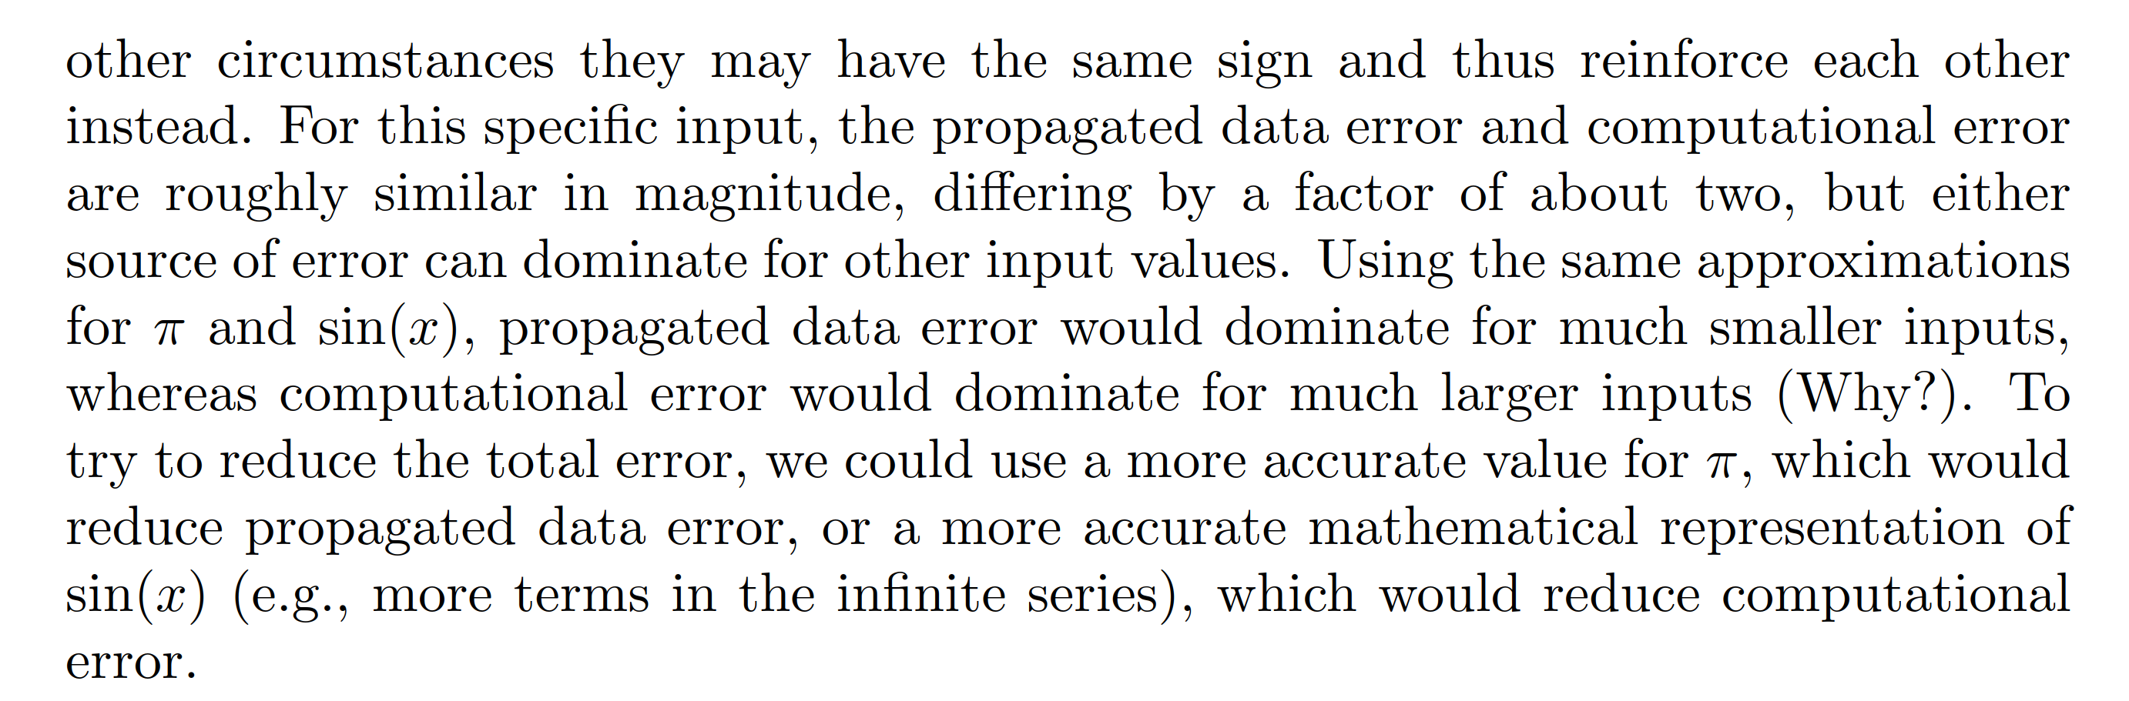
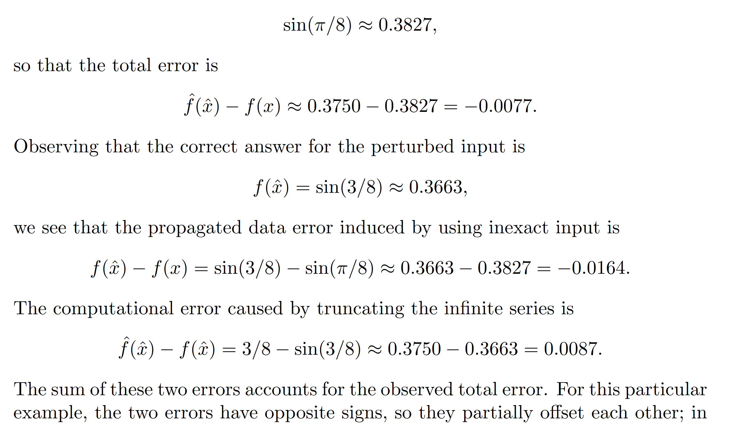
Example 1 - Data Error and truncation Error
Check if you want to add this, could be an exercise
Notes:
some customers want extreme accuracy – although there are huge uncertainties in their model

Slide 12
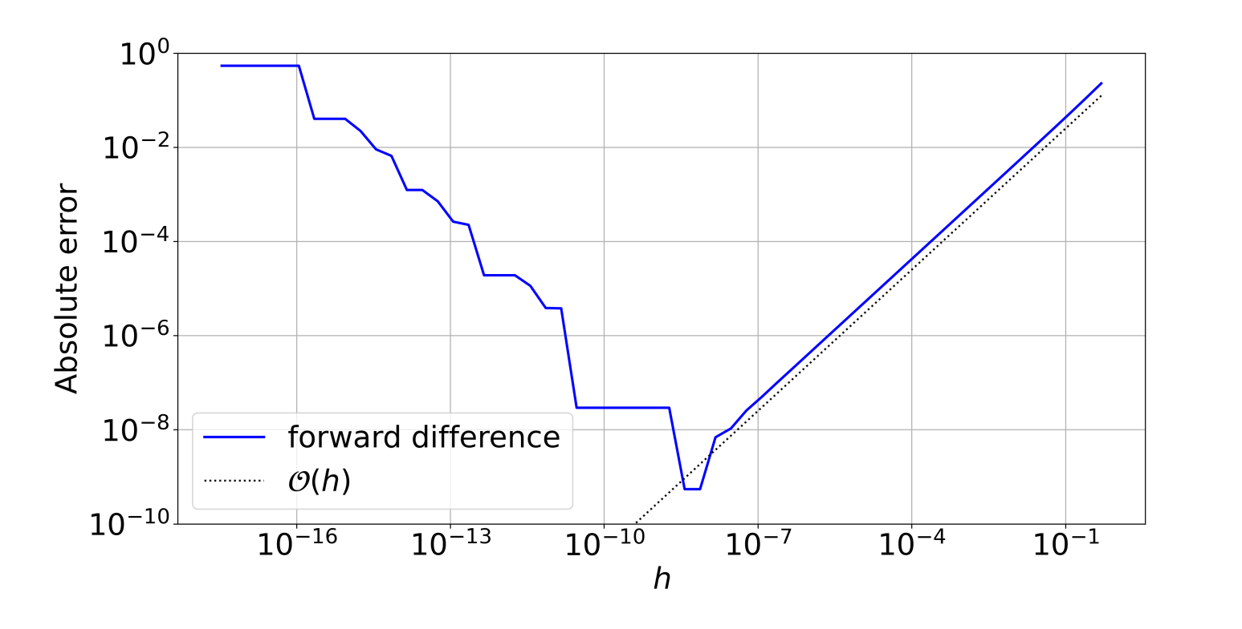
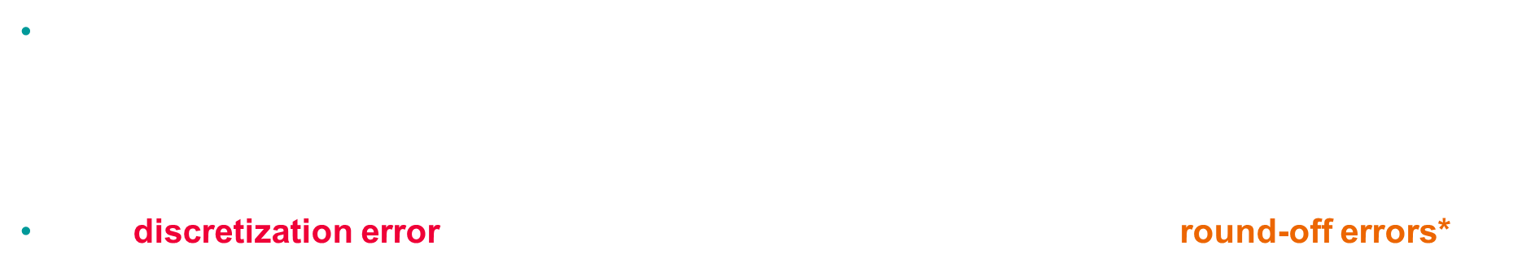
Round-off vs discretization errors An example
Exercise 2
Derivative approximation (see exercise)
$$f^{′}\left(x_{0}\right)=\frac{f\left(x_{0}+h\right)−f\left(x_{0}\right)}{h}+O(h)$$
The discretization error is linear with $h,$ but when h is too small, we have round-off errors*
Total error
Rounding error
Discretization
Error
*today’s topic, computer floating-point representation
Notes:
First order Finite difference

Slide 13

1.3 Representation of real numbers

Slide 14


Floating-point representation
A computer has a finite capacity and cannot store all real numbers (π ≈ 3.14159...)
Floating point representation of $x∈R$
$$fl\left(x\right)=±m×b^{e}, m=(\frac{d_{0}}{b^{0}}+\frac{d_{1}}{b^{1}}+…+\frac{d_{0}}{b^{p−1}})$$
m is the mantissa, e: exponent, b: basis, p: precision
In base 10, floating point ⬄ usual scientific notation
Let us choose $fl\left(x\right)= 152 853.50, b = 10, p = 8, e = 5$
$152853.50 = 1.5285350 ×{10}^{5}=\left(1×{10}^{0}+5×{10}^{−1} +…+0×{10}^{−7} \right)×{10}^{5}$
Notes:
The key idea is that both representations allow for expressing very large or very small numbers efficiently by focusing on the most significant digits and scaling with powers of 10. However, floating-point representation is used in computing and has specific rules for how numbers are stored in binary (even though the conceptual structure is similar to scientific notation).

Slide 15
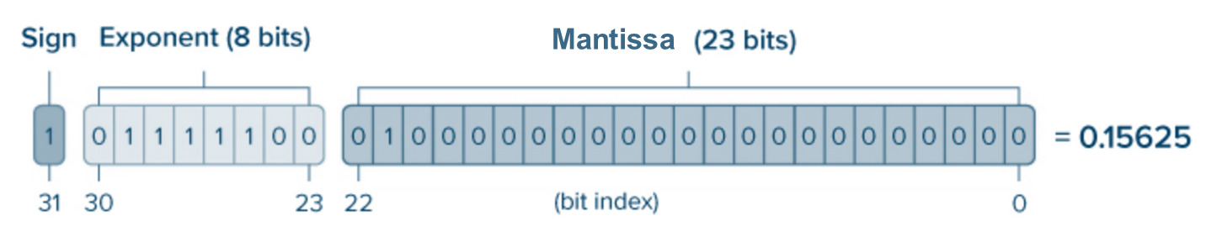

Floating-point representation single precision (IEEE-754) – 32 bits
A floating-point system is characterized by 4 values:
$(b, p, U, L)$base, precision, exponent upper and lower bound such as $L ≤ e ≤ U$
Single precision format (32 bits storage) – IEEE 754 standard
$b=2, p=23, L=−126, U=127$
$${\left(−1\right)}^{sign}×(1+Mantissa)×2^{ Exponent−127}$$
Notes:
Computer encodes in base 2, not in base 10 and it uses a biased exponent to allow encoding small and large exponents

Slide 16
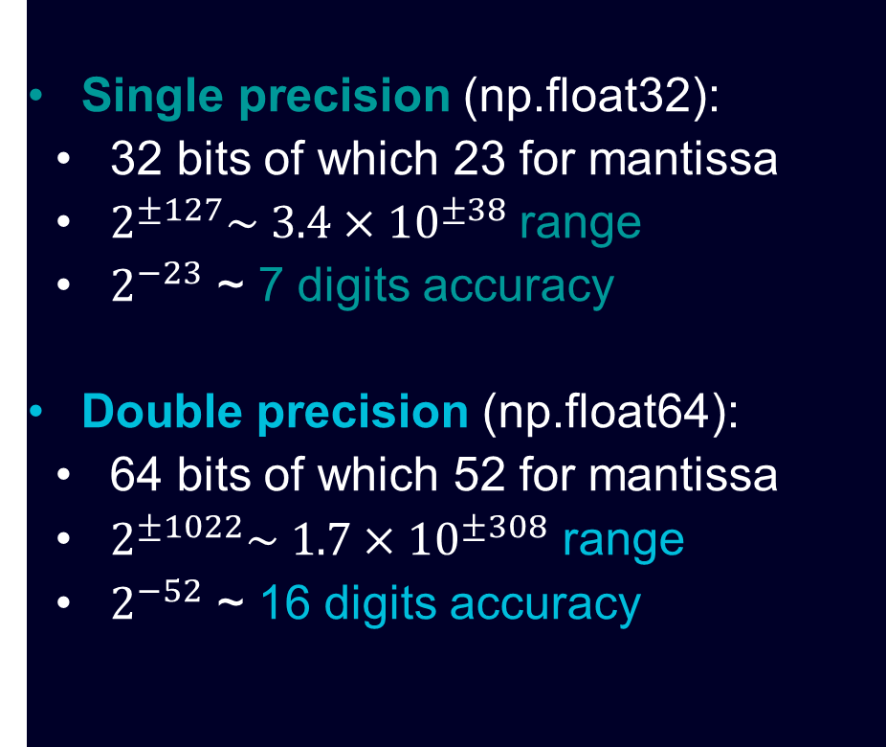

Single/double precision Example
Single precision (np.float32):
32 bits of which 23 for mantissa
$2^{±127}\sim 3.4×{10}^{±38}$ range
$2^{−23}$ ~ 7 digits accuracy
Double precision (np.float64):
64 bits of which 52 for mantissa
$2^{±1022}\sim 1.7×{10}^{±308}$ range
$2^{−52}$ ~ 16 digits accuracy
Example:
You are solving $Ax=b$ using an iterative solver (GMRES), but it's converging slowly.
You need to store 500 vectors, each representing a problem with 24 million degrees of freedom.
Question: How much RAM is required to store these vectors in double precision?
Notes:
24e6*(64/4 = 16) *500/1e9
ans =
192 Gb

Slide 17
1.4 Floating point arithmetic

Slide 18
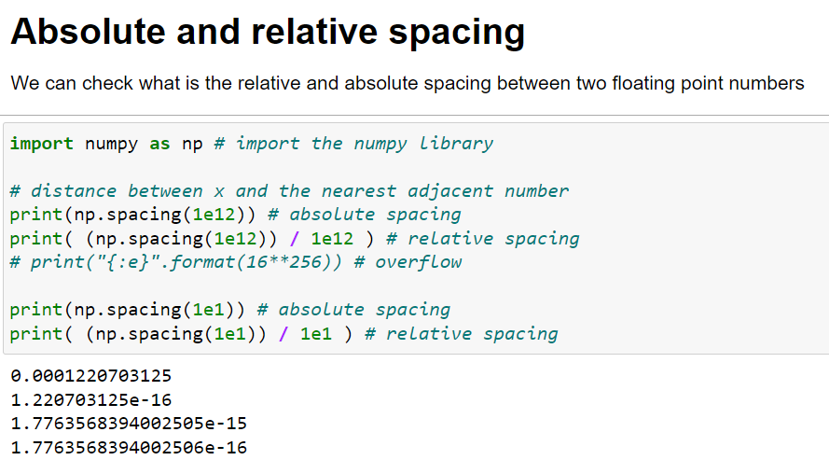
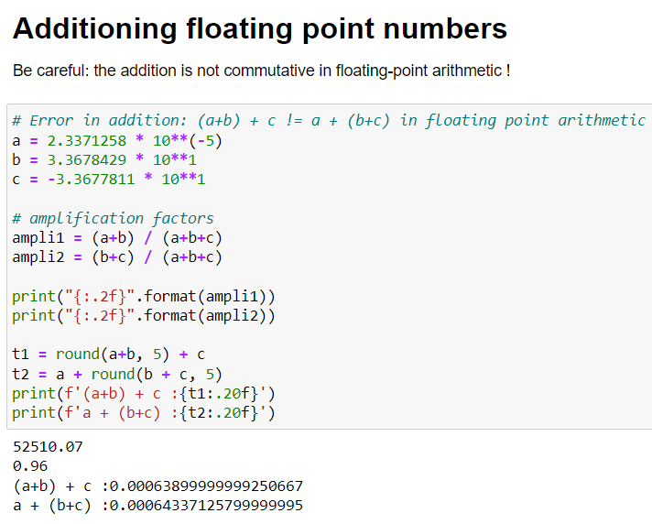
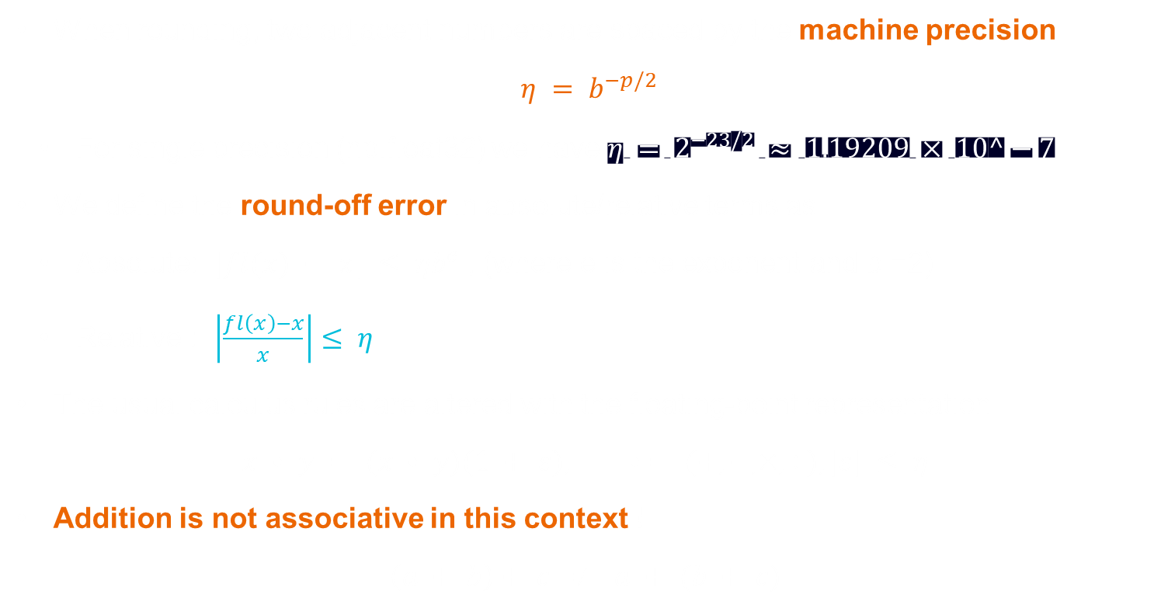
Machine precision
When rounding, two adjacent numbers are spaced by the machine precision
$η = b^{−p/2}$
For single precision (np.float32) we have $η = 2^{−23/2} ≈ 1.19209 × 10^−7$
We define the round-off error in absolute/relative terms as
Absolute: $|fl(x) − x| ≤ ηb^{e}$, (where e is the exponent and b =2)
Relative : $\left|\frac{fl\left(x\right)−x}{x}\right|≤ η$
The usual calculus rules are altered with the floating-point representation
$$x • y = (x • y)(1 + ε), • = (+, −, ×, ÷), |ε| ≤ η$$
Addition is not associative in this context !
$$\left(a + b\right)+ c ≠ a + (b + c)$$
Notes:
The spacing of a floating-point system is constant in the relative sense

Slide 19
Operations in floating point arithmetic

Slide 20
1.5 Conditioning and stability

Slide 21

Stability
Stability is an important concept in numerical analysis, and is found in different contexts:
Stability of numerical schemes (e.g. ODEs, finite differences),
Stability of numerical algorithms (e.g. linear systems),
It is linked to the propagation of errors during the computation.
Stability has also meanings at the continuous level (PDE, dynamical systems).

Slide 22
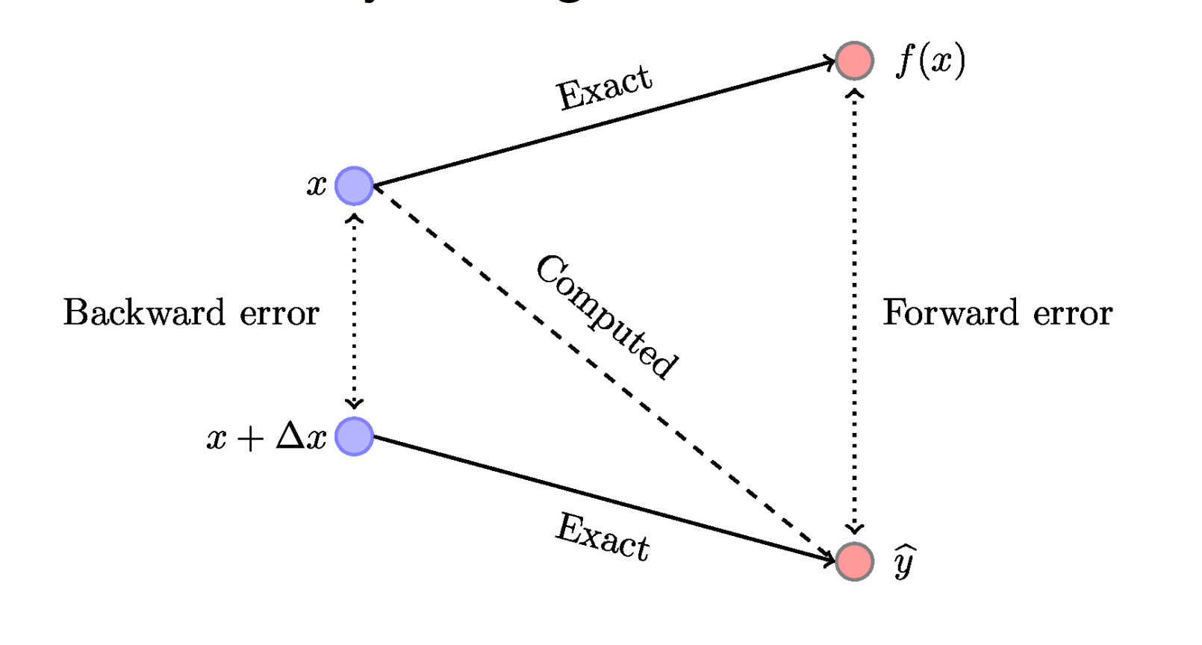
Stability
The forward error measures the difference between the computed and exact value $|\hat{y} − y|$
The backward error is the error on the input: $|\hat{x} −x|$, for a perturbed output $\hat{y}=f(\hat{x})$
If the backward error is “small”, we say the algorithm to be backward-stable
Illustration from Nicholas J. Higham blog

Slide 23
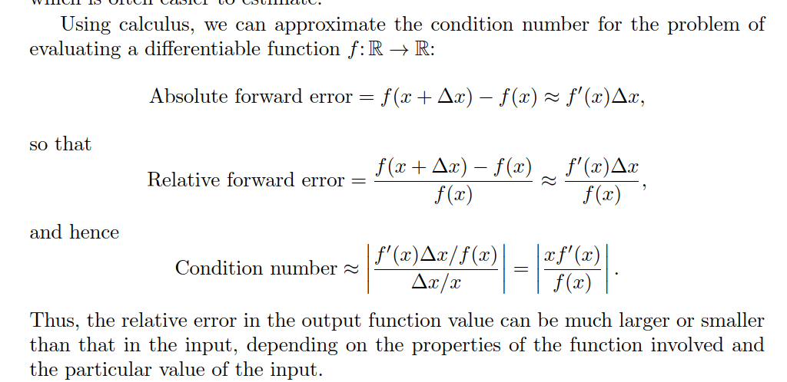
Conditioning
The condition number is the ratio of a relative change in the output to a relative change in the
Input. Condition number κ
κ = |(f (xˆ|)(−xˆ−f(xx)))/f (x)|
We have the relation
|relative forward error| = Condition number ×|relative backward error|
It represents the sensitivity related to the input data.
Conditioning depends on the problem, stability depends on the algorithm
For a C^1 function differentiable function f
κ = |(f (xˆ|)(−xˆ−f(xx)))/f (x)|= |xf’(x)/f(x)|
Notes:
We recognize the numerator and denominator in this ratio as the relative forward and backward errors, respectively, so this relationship can be rephrased
X_hat = x + delta x

Slide 24
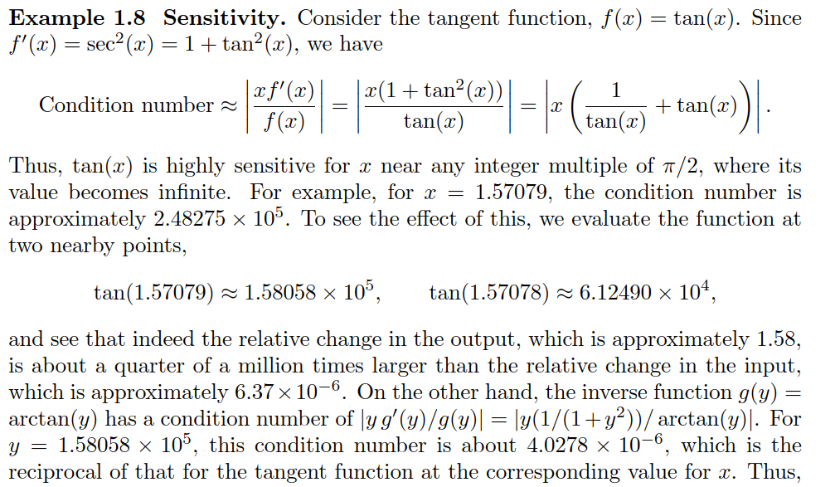
Could be an exercise
Notes:
1. Function: f(x)=xf(x) = \sqrt{x}f(x)=x​
Domain: x≥0x \geq 0x≥0
Derivative: f′(x)=12xf'(x) = \frac{1}{2\sqrt{x}}f′(x)=2x​1​
Conditioning:
As x→0+x \to 0^+x→0+, f′(x)→∞f'(x) \to \inftyf′(x)→∞, indicating high sensitivity (poor conditioning).
As xxx increases, f′(x)f'(x)f′(x) decreases, showing better conditioning for larger xxx.
Function: g(x)=a−xg(x) = a - xg(x)=a−x
Domain: All real numbers
Derivative: g′(x)=−1g'(x) = -1g′(x)=−1
Conditioning:
The derivative is constant, meaning the function is well-conditioned for all xxx. Small changes in xxx result in constant changes in g(x)g(x)g(x).
Summary of Conditioning
f(x)=xf(x) = \sqrt{x}f(x)=x​: Poorly conditioned as x→0+x \to 0^+x→0+, well-conditioned for large xxx.
g(x)=a−xg(x) = a - xg(x)=a−x: Well-conditioned for all xxx.
h(x)=tan⁡(x)h(x) = \tan(x)h(x)=tan(x): Poorly conditioned near π2+kπ\frac{\pi}{2} + k\pi2π​+kπ, well-conditioned elsewhere.

Slide 25
1.6 Summary

Slide 26
Summary
All machines use a floating-point representation,
We must be very careful during computations to avoid round-off errors,
Conditioning depends on the problem, stability depends on the algorithm
Designing numerically stable algorithms is in general not trivial

